Slide 1
CDP104 – Standards Tools and Framework
Thursday, June 08, 2017
Dewayne Hafenstein
Principal Technical Architect

Slide 2
You are HERE!
CDP101 – Introduction to MicroServices
CDP202 – Domain Driven Design
CDP103 – Introduction to the Continuous Deployment Platform
CDP104 – Introduction to Standard Tools and Frameworks
CDP205 – Using the MicroServices Catalog
CDP206 – Developing an Application Using MicroServices
CDP207 – Developing MicroServices
CDP308 – MicroServices Problem Determination and Monitoring
CDP409 – Using Docker Containers
CDP410 – Using Kubernetes
101
202
103
You are HERE
104
205
206
207
308
409
410

Slide 3
Quick View Page
Your Course Outline
Introduction
Describes how CDP integrates tools and open-source products together to implement the CI/CD processes.
Workstation
Describes the workstation tools that are used with CDP.
CDP Infrastructure
Describes the infrastructure products and tools used by CDP.
Build System
Describes the build system, the tools used to perform the build, the reason why unit testing, code coverage, and code analysis are important, and discusses the java tooling as a concrete example.
Runtime
Discusses the runtime frameworks and products used by CDP to manage the execution of the microService.
Monitoring
Discusses the tools and products used by CDP to capture and analyze the logs, metrics, and alerts and alarms from the microServices.
Your Course Overview
This course explains what tools, technologies, and frameworks have been chosen to work with the CI/CD model implemented by CDP, why they were chosen, and the motivation for their use.The purpose of this training is to introduce the tools that are part of the CDP framework.
These tools are used throughout the framework to support all aspects of CI/CD for microServices.
The tools discussed in this training are for a java-based microService. If a different technology is used, the tools will be different. The tools discussed are organized into several divisions.
Intended Audience
Developers, Architects, Solution Architects, Testers, Managers, Scrum Masters, Product Owners, Product Owner Delegates
Prerequisites
CDP 101 and 103

Slide 4


Before You Start
You’ll need to see both the slide and the notes section below. If you don’t see the notes section, click on “Notes Page” within the “View” tab. If viewing the presentation as a slide show, you may also see the notes on the presenters page.
Notes are not visible using the PowerPoint Viewer.
Notes:
These slides have a significant amount of notes added to them to explain the content. This is done so that reading the notes is essentially what an instructor leading the course would have said. There is a good amount of explanation in the notes that may be missed if you look only at the slide.
The notes can be viewed using several different approaches. If you are viewing the presentation as a slide show, the presenters view will show the slide and the notes. If you have opened the presentation in PowerPoint, you can view the notes using one of several means:
Select the “View” menu, then select “Notes Page”
In the normal view, use your mouse to select a divider along the bottom of the slide and move it up. This will show both the slide and the notes.
Please note, if you are using the power point viewer, the notes will not be visible. You will need to use PowerPoint to view the presentation content in its entirety.

Slide 5
Contents
Introduction
Workstation
CDP Infrastructure
Build System
Runtime
Monitoring

Slide 6
Introduction
Introduction
The purpose of this training is to introduce the tools that are part of the CDP framework...
These tools are used throughout the framework to support all aspects of CI/CD for microServices.
The tools shown here are for a java-based microService.
If a different technology is used, the tools will be different.
The tools discussed are organized into the following divisions:
CDP Tools
Workstation | CDP Infrastructure | Build System | Runtime | Monitoring
Eclipse | Git microService Catalog Eco AAF | Jenkins Sonar Java jUnit | Nexus Kubernetes Docker GRM DME2 | Fluentd Elasticsearch Kibana Prometheus
The actual set of tools used in the build system will vary by technology employed to develop the microService.
Introduction
Notes:
This course is going to introduce you to a large set of tools and products used by CDP to perform the CI/CD processes for microServices.
These tools and processes are not the complete set, because the actual set of tools used in the build system will vary by the language and technology used by the microService.
The tools and products used on the workstation, the CDP infrastructure itself, the runtime, monitoring of deployed microServices, and the management of the build system itself will be the same from one technology to the other.
This course focuses on the tools that do not change from one technology to another, and covers the tools used for java development specifically.
If the microService is built using node.js, the build environment is predominantly the only environment that is affected, and may use different construction, analysis, and testing tools.
Every combination of every supported microService implementation language or technology is not covered here.
To organize the information in this class, the standard tools are divided into five categories. These categories are:
Workstation – These are the tools that are standard and always installed and used by the engineer on their workstation environment.
CDP Infrastructure – These are the tools that are always used in all microService implementation technologies and form the basis for the CDP system itself.
Build System – These are the tools used to perform the build, test, analysis, packaging, and repository management of the microService image. These tools will always be run within a Jenkin system, but the tools themselves will vary from one technology to another. This course describes the java-based microService tooling.
Runtime – These are the tools that are always used for every microService implementation to execute the microService.
Monitoring – These are the tools used to monitor the microService execution and are common for all implementation technologies.

Slide 7
Standard Tools
CDP interfaces with many tools and frameworks
The set of tools supported is fixed, and was selected to offer the widest possible usage.
These tools are individually documented and lots of information is available for each
CDP’s use of them is based on the CI/CD processes and the framework design.
CDP also provides management functionality, such as….
…Registries
…Consoles
…Initialization and start-up support for the generation of the microService project
Introduction
Notes:
CDP uses a system integration approach to CI/CD, using the best tools available for each of the tasks in implementing CI/CD. These tools are integrated together by the CDP infrastructure and used to implement the CI/CD process the way we need it to operate.

Slide 8

Check Your Progress

Slide 9
Exercises
A+
Introduction to Standard Tools and Framework
The workstation tools will likely be the same for all microService technologies. | True/False
The build system tools used to construct, package, and test the microService do not change for different implementation technologies. | True/False

Slide 10
Contents
Workstation
These are the tools
that are standard, and
always installed and used by the engineer
on their workstation environment.
Introduction
Workstation
CDP Infrastructure
Build System
Runtime
Monitoring
Notes:
To organize the information in this class, the standard tools are divided into five categories. These categories are:
Workstation – These are the tools that are standard and always installed and used by the engineer on their workstation environment.
CDP Infrastructure – These are the tools that are always used in all microService implementation technologies and form the basis for the CDP system itself.
Build System – These are the tools used to perform the build, test, analysis, packaging, and repository management of the microService image. These tools will always be run within a Jenkin system, but the tools themselves will vary from one technology to another. This course describes the java-based microService tooling.
Runtime – These are the tools that are always used for every microService implementation to execute the microService.
Monitoring – These are the tools used to monitor the microService execution and are common for all implementation technologies.

Slide 11
Eclipse
Eclipse is a free, open-source, extensible Integrated Development Environment/IDE
Eclipse…
…is written mostly in java and is available for nearly any developer workstation environment.
…is highly extensible by the addition of plug-ins and features.
…can be used to develop Ada, ABAP, C/C++, Cobol, D, Fortran, Haskell, JavaScript, Julia, Lasso, Lua, NATURAL, Perl, PHP, Prolog, Python, R, Ruby (and Ruby on Rails), Rust, Scala, Clojure, Groovy, Scheme, Erlang, and of course Java.
…includes modeling tools for database schemas, XML and XML schemas, BPMN, SysML, OCL, and UML, as well as others.
…includes extensions to add specializations, such as the Web Tools Platform for developing and supporting web applications, PHP Development tools, Android development tools, and many more.
In general, the Eclipse Foundation provides four services to the Eclipse community:
IT Infrastructure
Intellectual Property Management
Development processes
Ecosystem Development
Workstation
Notes:
Eclipse was developed from the IBM VisualAge IDE and was donated to the open source community by IBM. In order to maintain Eclipse as a free and independent IDE, the Eclipse Foundation was formed.
The Eclipse Foundation is a not-for-profit, member supported corporation that hosts the Eclipse projects and helps cultivate both an open source community and an ecosystem of complementary products and services.
The Eclipse Project was originally created by IBM in November 2001 and supported by a consortium of software vendors. The Eclipse Foundation was created in January 2004 as an independent not-for-profit corporation to act as the steward of the Eclipse community. The independent not-for-profit corporation was created to allow a vendor neutral and open, transparent community to be established around Eclipse. Today, the Eclipse community consists of individuals and organizations from a cross section of the software industry.
The Eclipse Foundation is funded by annual dues from it’s members and governed by a Board of Directors. Strategic Developers and Strategic Consumers hold seats on this Board, as do representatives elected by Add-in Providers and Open Source committers. The Foundation employs a full-time professional staff to provide services to the community but does not employ the open source developers, called committers, which actually work on the Eclipse projects. Eclipse committers are typically employed by organizations or are independent developers that volunteer their time to work on an open source project.
In general, the Eclipse Foundation provides four services to the Eclipse community:
1) IT Infrastructure, 2) Intellectual Property Management, 3) Development processes, and 4) Ecosystem Development.
Full-time staff are associated with each of these areas and work with the greater Eclipse community to assist in meeting the needs of the stakeholders.
Industry leaders Borland, IBM, MERANT, QNX Software Systems, Rational Software, Red Hat, SuSE, TogetherSoft and Webgain formed the initial Eclipse.org Board of Stewards in November 2001. By the end of 2003, this initial consortium had grown to over 80 members.
On Feb 2, 2004 the Eclipse Board of Stewards announced Eclipse’s reorganization into a not-for-profit corporation.
Originally a consortium that formed when IBM released the Eclipse Platform into Open Source, Eclipse became an independent body that drives the platform’s evolution to benefit the providers of software development offerings and end-users.
All technology and source code provided to and developed by this fast-growing community is made available royalty-free via the Eclipse Public License.

Slide 12
Eclipse
The Eclipse Foundation maintains and supports Eclipse and many plugins
The Eclipse Foundation maintains a web presence at http://www.Eclipse.org.
Eclipse and many plugins can be freely downloaded from this site.
Eclipse is composed of…
…the platform (the runtime framework).
…many projects (these add specialized capabilities and are built and packaged as sets of plugins).
…many available plugins (these add specific capabilities and features to the workbench and are smaller than a project).
Many other sources of plugins exist, as well
Many vendors supply plugins for their products.
Many open source projects supply plugins for special purposes.
Workstation
Notes:
The Eclipse Foundation maintains a web presence at http://www.Eclipse.org.

Slide 13
Eclipse
Eclipse uses an annual simultaneous release of the platform and major projects together
The simultaneous release is given a themed name.
The names used in the past were astronomy related (such as the moons of Jupiter, the sun, and astronomers).
The current names are still science-related (Neon, Oxygen, Photon).
Plugins, the platform, and projects may have additional releases as needed
Eclipse releases use a version number to uniquely identify each release.
Each simultaneous release synchronizes the platform and projects each year and represents a fully tested, integrated product.
Other releases still occur throughout the year of each individual component.
Workstation
Notes:
Each year the Eclipse Foundation and its projects produce a release on a coordinated schedule.
This release is often referred to as the simultaneous release, coordinated release, release train, or annual release of Eclipse.
Each coordinated release typically occurs in June, with follow-up update releases in September (*.1), December (*.2), and March (*.3).

Slide 14
Eclipse Packages
Eclipse is available for download as standard packages
This is to make it easier to get the right combination of tools for you initially.
Each package is the workbench with a defined set of projects and plugins included.
Eclipse Package | Description
Eclipse IDE for Java EE Developers | Tools for Java developers creating Java EE and Web applications, including a Java IDE, tools for Java EE, JPA, JSF, Mylyn, EGit and others.
Eclipse IDE for Java Developers | The essential tools for any Java developer, including a Java IDE, a Git client, XML Editor, Mylyn, Maven and Gradle integration
Eclipse IDE for C/C++ Developers | An IDE for C/C++ developers with Mylyn integration.
Eclipse for Android Developers | An IDE for developers creating Android applications.
Eclipse for PHP Developers | The essential tools for any PHP developer, including PHP language support, Git client, Mylyn and editors for JavaScript, HTML, CSS and XML.
Eclipse IDE for JavaScript and Web Developers | The essential tools for any JavaScript developer, including JavaScript language support, Git client, Mylyn and editors for JavaScript, HTML, CSS and XML.
… and many more
Workstation

Slide 15
Extending Eclipse
Any Eclipse “package” can be extended by installing features and plugins
A package is just a pre-packaged set of features and plugins that are downloaded and installed at the same time
You can add (or remove) features and plugins at any time.
For example, the “Eclipse IDE for Java EE Developers” package can have the C/C++ development features installed afterwards.
The several sources of Eclipse plugins are…
…the Eclipse Marketplace (maintained by the Eclipse Software Foundation).
…update sites from specific vendors as well as the Eclipse Software Foundation and open-source projects.
Workstation

Slide 16
Check Your Progress

Slide 17
Exercises
A+
Workstation
Eclipse is a free, open-source, extensible integrated development environment (IDE). | True/False
Eclipse can be used only to develop java applications. | True/False
Eclipse packages cannot be extended or changed after download. | True/False
Eclipse software releases are only available once each year as the simultaneous release. | True/False
Eclipse plugins can only be downloaded from the Eclipse Software Foundation. | True/False

Slide 18
Contents
Introduction
Workstation
CDP Infrastructure
Build System
Runtime
Monitoring
CDP Infrastructure
These are the tools that are always used in all microService implementation technologies and form the basis for
the CDP system itself.
CDP Infrastructure
Notes:
To organize the information in this class, the standard tools are divided into five categories. These categories are:
Workstation – These are the tools that are standard and always installed and used by the engineer on their workstation environment.
CDP Infrastructure – These are the tools that are always used in all microService implementation technologies and form the basis for the CDP system itself.
Build System – These are the tools used to perform the build, test, analysis, packaging, and repository management of the microService image. These tools will always be run within a Jenkin system, but the tools themselves will vary from one technology to another. This course describes the java-based microService tooling.
Runtime – These are the tools that are always used for every microService implementation to execute the microService.
Monitoring – These are the tools used to monitor the microService execution and are common for all implementation technologies.

Slide 19

microServices Catalog
The microServices Catalog is used to track microServices
Every microService intended for production must have an entry.
Currently, the catalog is manually administered.
Entries must be manually created.
Entries must be manually updated.
The catalog entry should link to detailed information
The microService catalog entry should reference the detailed information about the service, and should include…
…the domain model.
…the API details.
…MOTS system for information about ownership of the microService.
CDP Infrastructure

Slide 20

microService Catalog
The microService catalog is currently implemented in SharePoint
This will change in the future.
The catalog maintenance may be integrated within CDP processes.
The catalog implementation may change over time.
The microService Catalog is being revised and this course will be updated when the new catalog is available
CDP Infrastructure

Slide 21
CDP ECO
The ECO tool in CDP manages the pipeline
ECO is part of CDP.
ECO uses a collection of pre-defined templates for certain types of microServices.
The user generates a microService using ECO, by selecting a template. ECO uses the template to do the following:
Setup the repository
Setup the project
Create the initial boilerplate code and artifacts of the project
Commit to the Git repository
Setup Jenkins for building and automating the project
Define the job
Build the microService
ECO is a custom AT&T written application
CDP Infrastructure

Slide 22
ECO Templates
ECO Templates can be added
ECO allows new templates to be added.
ECO allows existing templates to be updated.
Changes to a template DO NOT affect existing microServices.
Once a microService project is generated from a template, that template is not used again for that microService.
The template can be changed any time later and will have no effect on existing projects.
CDP Infrastructure

Slide 23
The CDP Pipeline
The pipeline defines the CI/CD process
The pipeline is initially created when the project is generated.
The pipeline definition is created from the template.
Pushes to the Git repository can automatically trigger the pipeline
Git can use a trigger to notify ECO when changes have been pushed to the repository.
The notification to ECO can be used to automatically run the pipeline to execute the CI/CD process.
Pipeline execution can be manually requested
If desired, the pipeline may be manually executed as well, or instead of, the automatic mechanism.
CDP Infrastructure

Slide 24
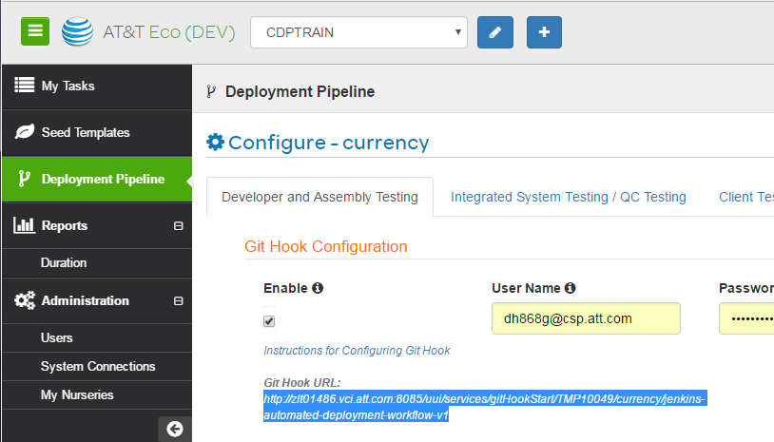
Registering the Git/ECO Trigger
You need the hook URL to set up the trigger to notify ECO of changes to the repository
The URL will be presented to you when you generate the microService project, or it can be obtained by examining the pipeline configuration.
To get the hook URL from ECO:
Open the pipeline.
Select configure.
Copy the hook URL.
CDP Infrastructure
Notes:
If you wish to have ECO automatically start the pipeline whenever changes are pushed to the repository, then you will need to configure the “hook” in Git that sends the notification to ECO.
Hooks are customization points in the Git process that can be configured for each repository. These hooks are automatically performed by Git when the condition to which they apply occurs. For example, Git defines a set of “Post Receive” hooks. These hooks are executed whenever the repository has completed the processing of a push (input to the repository).
One of the post receive hooks provided by Git is the ability to send a notification to a web resource (an Http URL). ECO listens on a specified URL for any such notification, and reacts by building the associated pipeline. The actual URL will vary by microService, as this is how ECO knows which microService to run the pipeline for.
The hook URL is provided in two different places in ECO. When the microService is first generated, the result of the generation provides the URL in the summary report. However, if you didn’t set up the hook at that point, you can still retrieve the hook URL to use later. To do that, you would:
Open ECO and sign in to ECO
Find your microService, and select the deployment pipeline for it
Select to configure the pipeline
Select the “Developer and Assembly” tab
The Git hook URL is provided on that page. Copy the URL for use in configuring the hook.

Slide 25
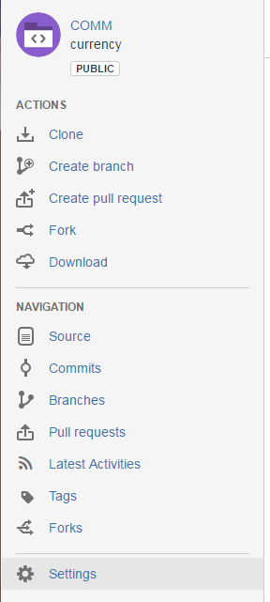
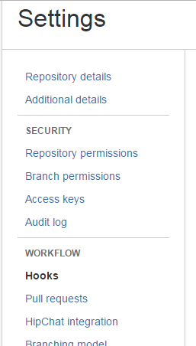
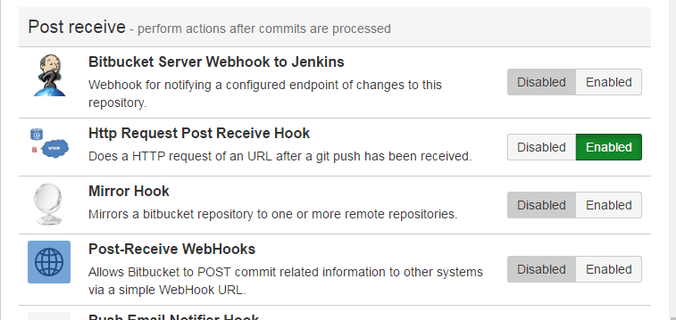
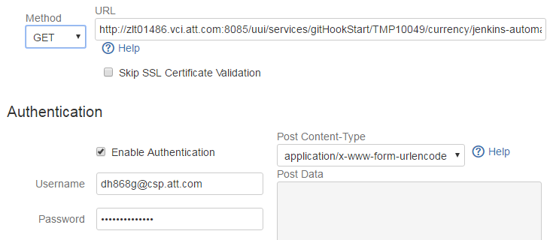
Registering the Git/ECO Trigger
Define the hook URL to Git
1. Open the repository in a browser
2. Select “Settings”
3. Select “Hooks” (under Workflow)
4. Select “Http Request Post Receive Hook”
5. Enter
URL
User ID
Password
Notes:
To define the hook in Git, open a browser and navigate to the Git repository. Use the repository that contains the microService for the pipeline we accessed in the previous page.
In the repository display in Git, perform the following:
Open the repository in a browser.
Select “Settings”.
Select “Hooks”.
Scroll down the list of hooks that can be set and locate the “Http Request Post Receive Hook” entry and select it.
Make sure the method is set to Get, and insert the URL, user id, and password used to authenticate to ECO.
You are configuring the hook definition that Git will use to connect to ECO and notify it that a repository change has occurred.
That notification requires Git to log in to ECO, so use the user id and password that is appropriate for ECO.
This should be the mechid associated with the microService, however it can be an ATTUID.
The user id has to be fully qualified and must include the csp domain (<attid>@csp.att.com).

Slide 26
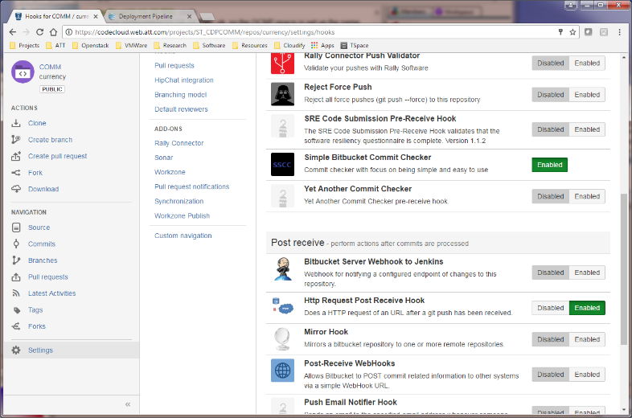
Registering the Git/ECO Trigger
Make sure the hook is enabled
CDP Infrastructure
Notes:
When completed, ensure that the hook is enabled.
Hooks can be disabled at any time.
This does not discard the configuration, it just “turns them off”. If a hook is disabled, it is ignored. Even if the condition occurs that the hook would normally be executed on behalf of, the hook is not executed if it is disabled.
You could use this to temporarily stop the pipeline process if you needed to for some reason.
When you want to restart the automated pipeline, re-enable the hook. Note, re-enabling a disabled hook does not cause it to be executed at that time. It will be executed the NEXT time the repository state changes.

Slide 27
SCM Repository
Git is the SCM repository used by CDP
Git is an open source and widely used SCM solution. It is very efficient and can handle large projects.
All of the Git features and capabilities are available for use.
Git has a simple branching strategy to enable multiple coding efforts at the same time. These branches can be easily merged at a later time.
You can use any developer client to access Git that you would normally use.
Eclipse: a Java-based IDE (Integrated Development Environment). Refer to http://www.Eclipse.org/ for more information.
Git: command line support. Refer to https://git-scm.com/ for more information.
Tortoise Git: a Git client used as a shell extension in a Windows environment. Refer to https://tortoisegit.org/ for more information.
SmartGit: a Git client used for Windows, Mac, and Linux.
CDP Infrastructure

Slide 28
Git Summary
Git is similar to other SCM tools in some ways, and different in others
Versioning is different than other SCM tools.
Terminology is somewhat different than other SCM tools.
The Work Area
Each user extracts a version of the files from the local repository into a work area (also called a work space or a working folder) for editing.
The Local Repository
Each user of the remote repository creates a cloned copy of it on their local workstation.
The local cloned copy is called the “local” repository.
The Remote Repository
The Git repository that manages all of the artifacts that comprise your project is centrally located and remote to your workstation.
The remote repository is usually shared by the entire team and the CDP tools performing the CI/CD process.
See: https://git-scm.com/book/en/v2/Getting-Started-About-Version-Control
CDP Infrastructure
Notes:
If you are new to Git, or even to SCM tools in general, then we recommend that you work through this on-line help document:
https://git-scm.com/book/en/v2/Getting-Started-About-Version-Control

Slide 29



Git Summary
Workstation
fetch
Local Repository
pull
clone
merge
fetch
Remote Repository
commit
pull
Edit, compile, test
Work area
push
Workstation
fetch
Local Repository
pull
merge
…and so forth,
for all other users that are accessing the repo
/other team members.
commit
Edit, compile, test
Work area
CDP Infrastructure
Notes:
When a user wishes to access a Git repository (remote), the user will “clone” that repository.
The clone operation creates a local repository on their workstation that is an exact replica of the remote repository.
It will also create a working directory or folder on the local workstation where the user performs all edits.
The user works with the local repository and their working folder.
When changes are ready, they are committed to the local repository.
Note: Commit does NOT send the changes to the remote repository, only to the local repository. When you are ready to send your changes to the remote repository, you push your changes to it. If you forget to push the changes, no one will ever see them because they only exist in your local copy.
Whenever you do a pull or fetch, the remote repository is read and compared to the local repository.
Any differences are merged automatically if possible and the local repository is updated. If the changes cannot be merged, a conflict is noted and you will have to manually resolve the conflict.
This can be performed by comparing the differences between your local and remote repository copies of the file(s) that are in conflict, and resolving the differences.
When the differences are resolved to your satisfaction, you would commit the resolved conflicting file(s) to your local repository and push them to the remote.
Git is more involved and can do much more than these few slides demonstrate.
These slides and the coverage in this course is intended to just introduce you to the concepts and operation of Git.
It is highly recommended that a full course on Git be used to further the students understanding if the student will be using Git as part of their processes.

Slide 30
Security
CDP uses AAF as the security framework
AAF uses namespaces…
…to define ownership and control domains.
…to define resources.
AAF defines permissions that define types of access to controlled resources.
AAF uses rules to grant or revoke privileges to resources.
Each microService will be identified using its own namespace
CDP Infrastructure

Slide 31
Check Your Progress

Slide 32
Exercises
A+
CDP Infrastructure
Every microService deployed into production must be registered in the microService Catalog. | True/False
The microService catalog contains all of the technical information about the microService. | True/False
ECO actually manages the pipeline used to build a microService. | True/False
ECO provides templates to assist in the generation of different types of microServices. | True/False
Changes to the Git repository cannot be detected by ECO. | True/False
The Git “commit” command commits your changes to the remote repository. | True/False

Slide 33
Contents
Introduction
Workstation
CDP Infrastructure
Build System
Runtime
Monitoring
Build System
These are the tools used to perform the build, test, analysis, packaging, and repository management of the microService image.
These tools will always be run within a Jenkins system, but the tools themselves will vary from one technology to another. This section describes the java-based microService tooling.
Notes:
To organize the information in this class, the standard tools are divided into five categories. These categories are:
Workstation – These are the tools that are standard and always installed and used by the engineer on their workstation environment.
CDP Infrastructure – These are the tools that are always used in all microService implementation technologies and form the basis for the CDP system itself.
Build System – These are the tools used to perform the build, test, analysis, packaging, and repository management of the microService image. These tools will always be run within a Jenkin system, but the tools themselves will vary from one technology to another. This course describes the java-based microService tooling.
Runtime – These are the tools that are always used for every microService implementation to execute the microService.
Monitoring – These are the tools used to monitor the microService execution and are common for all implementation technologies.

Slide 34
Jenkins
Jenkins is an open-source automation server
Jenkins is a free, open-source, automation server. It is highly configurable, and it’s behavior can be extended through the use of plugins.
Jenkins can be configured by installing plugins to add nearly any capability.
Jenkins can support building and deploying software in an automated way.
Typical use of Jenkins is to create and run “Jobs”.
Jenkins was extended using “pipeline” plugins.
Jenkins pipeline support is used to implement the CI/CD processes
There is a “jenkinsfile” added to the root of your microService project.
The “jenkinsfile” is a scripted definition of the pipeline, used by Jenkins for your microService.
Build System
Notes:
Jenkins is a free, open-source, automation server. It is highly configurable, and it’s behavior can be extended through the use of plugins.
There are two ways to automate the processing using Jenkins:
One is to use “jobs”. Jobs are created, configured, and stored in Jenkins. These jobs can be run at any time and perform the processing required. A job may automatically trigger a subsequent job, allowing chaining from one job to the next. This allows you to create complex build automation processes that may be conditionally executed.
Another way to automate processing is through the use of the pipeline plugins. These plugins extend Jenkins to allow it to perform processes that are defined by a “jenkinsfile” that is part of the project being built. This is the way ECO automates the build and deployment of microServices on Jenkins.

Slide 35
Jenkins
Jenkins can run maven and ant projects as well as scripts
This allows Jenkins to perform just about any “build” type operation that may be required for nearly any project.
Nearly any tool that can be run from a command-line can be executed under Jenkins.
Jenkins can be used to:
….construct (compile, translate, or assemble) the microService.
…package the microService.
…test the microService.
…run source code analysis tools.
…run test coverage analysis tools.
…deploy the package into a repository.
…and Jenkins can be used to do much, much more.
Build System
Notes:
Jenkins can run nearly any automation process.
It is primarily intended to automate the build environment for software, so it naturally supports the most common java-based project frameworks: maven and ant.
However, it can also run shell scripts as part of the process definition. This allows it to perform just about any process needed to build, package, test, deploy, or install software.

Slide 36
Scaling Jenkins
Jenkins can be scaled to handle massive loads
There can be master servers and slave servers.
Builds are deployed to slaves for execution.
Either masters or slaves can be replicated and deployed in clusters.
Builds can be distributed across slaves for load balancing.
Builds can have affinity to specific servers as well.
Jenkins Slave 1
Jenkins Slave 2
Jenkins Master
Jenkins Master
Jenkins Master
Jenkins Slave n
Build System
Notes:
Jenkins is designed to be scalable.
The Jenkins server can be installed and configured as a single node for very simple cases.
It can also be divided into a master and one or more slave nodes. The master directs the processing of the build processes on the slave nodes. In addition, the master node can be replicated and clustered together, to virtually no limit in the number of master and slave nodes, allowing extremely large build systems to be constructed if needed.

Slide 37
SDK
A software development kit, or it’s equivalent, is usually needed to build software
Computer languages use some form of processing program that can interpret the source and either perform the desired function or convert it into a program that can…
…via COMPILERS, convert the source files into binary, machine-executable files
…via INTERPRETERS, read the source files and directly implement the behavior without conversion to a machine-format file.
…via ASSEMBLERS, translate high-level symbolic machine instructions or macro instructions to binary machine-executable files.
…via LINKERS, combine multiple machine-readable intermediate files into an executable format, resolving all references.
Different languages use different approaches.
Java source files are converted into an intermediate form, called “byte code” by the java compiler.
These byte code files (class files) are then converted to platform-specific instructions and executed by the JVM.
Java does not use assemblers and linkers, however, some languages do.
The tools used to build, package, and perform development activities is a development environment, or SDK
A software development kit (SDK or devkit) is typically a set of software development tools that allows the creation of applications for a certain software package, software framework, hardware platform, computer system, video game console, operating system, or similar development platform.
Build System

Slide 38
SDK
Some SDK (Software Development Kit) or equivalent will be needed on the build system
Different build environments are needed based on the technology of the microService.
Whatever is appropriate for the target technology is used.
The actual SDK used will be determined by the template used to generate the microService.
The Java SDK is used for java-based microServices
JDK (Java Development Kit) is a combination of software tools and libraries that allows a programmer to write, compile, debug, and package a Java application. The JDK includes the JRE.
JRE (Java Runtime Environment) is a package of software products and libraries that allows a java application to be executed on a specific platform. This can be installed on a platform to run a java application where the entire JDK is not needed.
jar - Java Archive, a file format compatible with the zip file format that allows for the packaging of java programs (source or compiled binaries) for deployment purposes.
javac - The java compiler. This is the product, included only with the JDK, that compiles java source code files into class binary files for execution.
java - The Java Virtual Machine. This is the java virtual machine interpreter that loads and runs class files.
Build System

Slide 39
Design for Testability
CODE must be designed for testability
Follow good OOD/OOP practices.
In addition, the following suggestions may help…
Favor loose coupling and high cohesion.
The fewer the dependencies the easier it is to isolate the unit for testing.
The more cohesive the unit is, the easier the testing will be.
Favor composition over inheritance.
Composition allows you to modularize the solution and provide easier testing of smaller units.
Testing of overloaded or overridden methods may be difficult and can be easily overlooked.
Favor polymorphism over conditional expressions.
Separate classes to implement specialized behaviors are easier to test than complex conditional logic.
Build System
Notes:
Software becomes more testable when it can be exercised in isolation. Conversely, the more a class or program depends on other classes or programs to operate, the harder it is to test it.
This is true for simple dependencies between programs, and also for dependencies between a program and it’s environment. For example, if a program obtains the current time and uses that value to make some determination, then testing that program becomes problematic.
The test case can’t, or shouldn’t, manipulate the system time in order to test the code.
A better approach would be to provide the time as an argument so that the code can be tested for any value or range of values at any time of day.
In general, the more independent a program or class is from any dependencies and its environment, the easier it will be to test it.
Another common pitfall is the use of global state.
This takes the form of static fields in java, for example.
Nearly all languages have a similar capability.
Static or global data has one value no matter how many objects are created from the class. Worse, that data is not automatically cleared or reinitialized from one instance to another.
Since most unit test frameworks (such as jUnit) only load the class once, the static data is retained from test to test and can create unpredictable and unreliable test results.
Singletons are just another way to implement global state, and suffer from the same failings. If the component being tested requires the use of global state (global static fields or singletons), then the test cases may have to deal with that.
There may be a requirement to be able to reset or clear that global state between test cases. This is not uncommon, but needs to be taken into consideration.

Slide 40
Testing
TESTING TOOLS are used by the build system to verify functionality
Different testing tools will be used for different technologies.
Whatever is appropriate for the target technology is used.
The actual testing tools used will be determined by the template used to generate the microService.
jUnit is used as the testing tool for java-based microServices
For more information on JUnit, refer to the following link http://junit.org/junit4/.
Build System
Notes:
For more information on JUnit, refer to the following link http://junit.org/junit4/.

Slide 41
Source Code Analysis
Source Code Analysis tools are used to check the code for conformance to norms
Source code analysis generally…
…parses and analyzes the source files by applying rules for acceptable construction.
…measures the size of the source units (classes, methods, files, etc.).
…measures the complexity of the source and estimates the supportability.
…provides metrics about the source code “quality”.
…may provide trending over time to assist in managing the code.
…includes test coverage analysis.
Benefits of source code analysis
There are many benefits, but generally they include…
Detection and identification of common coding problems and potential errors
Analysis of complexity and identification of potential areas of concern with regard to support and maintainability, and ultimately high cost
Identifies areas of the application that are not being adequately tested
Providing feedback to constant improvement efforts
Build System

Slide 42
Source Code Analysis
CODE ANALYSIS TOOLS are used by the build system to verify code quality
Different tools are used for different technologies.
Whatever is appropriate for the target technology is used.
The actual analysis tools used will be determined by the template used to generate the microService.
Some technologies may not have an available code analysis tool.
SonarQube is used for Java-based microServices
Build System

Slide 43
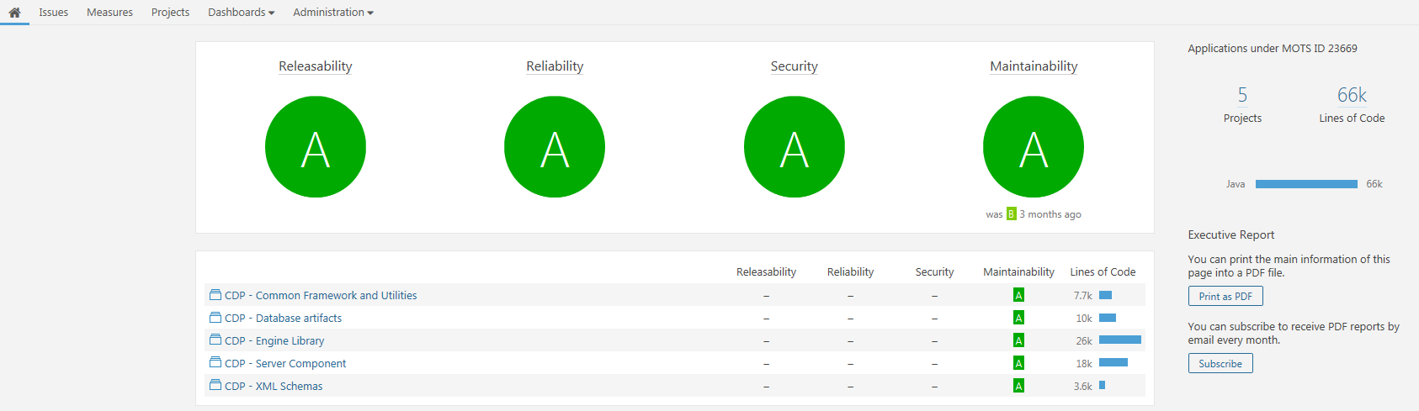
SonarQube
Using SonarQube
In the SonarQube Web interface below, there is a grade for each category monitored by SonarQube.
These grades can vary depending on the rules setup for Releasability, Reliability, Security, and Maintainability categories.
Build System

Slide 44
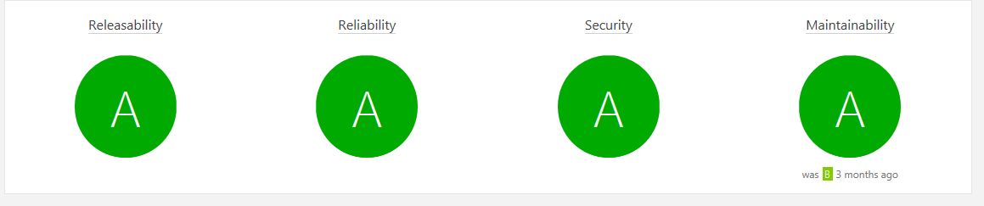
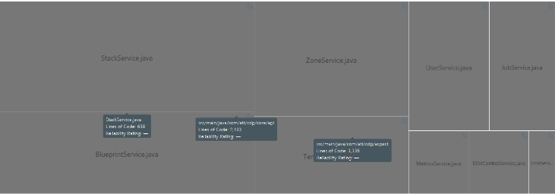
SonarQube
Using SonarQube
Click on one of the categories to drill-down into the coding file structure.
You are able to go down to the individual source files.
Clicking on the individual source files displays the code for each.
Build System

Slide 45
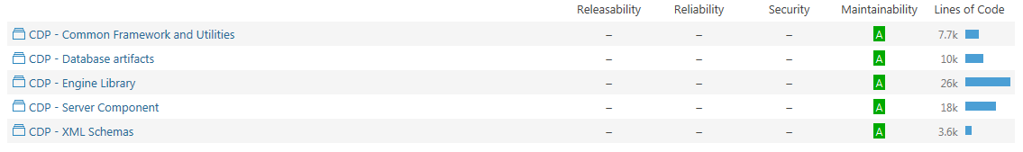
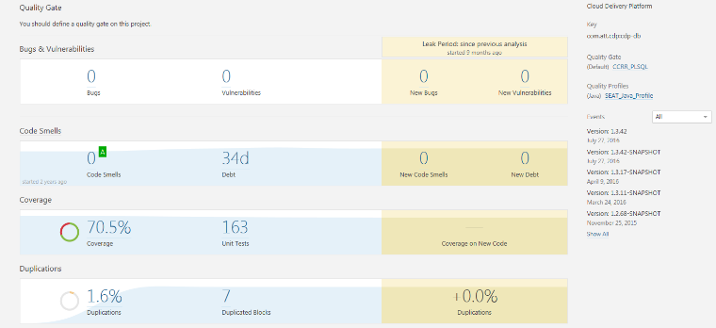
SonarQube
Using SonarQube
Click on one of the functional areas below to open a quality gate.
The quality gate displays a detailed analysis of the code for that functional area.
Build System

Slide 46
SonarQube
Using SonarQube
Quality Category | Definition
Bugs & Vulnerabilities | Displays the total of any bugs and discovered code vulnerabilities.
Code Smells | Code that needs remediation.
Coverage | The amount of lines of codes that are actually executed. If you have 100 lines of code and 60 lines execute, your coverage is 60%
Duplications | Any duplications in the code that are not needed for the final execution of the code.
Size | Based on execution paths and other criteria, this measures if the size of the code base is too big for efficient execution of the code.
Build System

Slide 47
Test Coverage
Test Coverage
Many source code analysis tools include test coverage.
For those that do not, separate test coverage tools may be employed.
Test coverage reports how much of your source is actually being tested!
Coverage tools instrument (monitor at the statement level) the application while it is being tested.
They measure the actual statements that are tested by each test case, and identify which statements are NOT being tested.
The result is a percentage of coverage.
63% coverage means that 63% of your source code is actually being executed and exercised by test cases. More importantly, that 37% is NOT being tested at all!
For example, if the application consists of 253,651 lines of code (uncommented), and after all test cases are run, 175,209 lines are actually executed, then the test coverage is 69%.
Build System

Slide 48
Test Coverage
Test Coverage is important, and the threshold will vary for different products.
The target for adequate coverage is different for different products, and is usually based on a cost vs. risk analysis.
For life support systems, 100% coverage is usually required.
For an online ordering system, 60% (or better) coverage may be acceptable.
The costs to develop better test coverage increases as coverage increases.
It requires more analysis.
It gets increasingly more difficult and expensive to achieve higher coverage as the rate increases.
It may require refactoring and reimplementation of software to improve coverage.
Tools like code coverage analysis can help improve quality and manage risks.
Build System

Slide 49
Test Coverage
Test Coverage is important, and the threshold will vary for different products
The target for adequate coverage is different for different products, and is usually based on a cost vs. risk analysis.
For life support systems, 100% coverage is usually required.
For an online ordering system, 60% (or better) coverage may be acceptable.
The costs to develop better test coverage increases as coverage increases
It requires more analysis.
It gets increasingly more difficult and expensive to achieve higher coverage as the rate increases.
It may require refactoring and reimplementation of software to improve coverage.
Tools like code coverage analysis can help improve quality and manage risks
Build System

Slide 50
Check Your Progress

Slide 51
Exercises
A+
Build System
Jenkins is a highly configurable, extensible, and flexible automation system used for building software. | True/False
CDP uses Jenkins to perform the build processes. | True/False
An SDK of some sort, appropriate for the technology of the microService, may be needed to be able to build it. | True/False
Unit testing is not performed by CDP in the build environment. | True/False
Source code analysis verifies that source conforms to a set of norms. | True/False
Test coverage reports on the success or failures of individual tests. | True/False

Slide 52
Contents
Introduction
Workstation
CDP Infrastructure
Build System
Runtime
Monitoring
Runtime
These are the tools
that are always used
for every microService implementation
to execute the microService.
Notes:
To organize the information in this class, the standard tools are divided into five categories. These categories are:
Workstation – These are the tools that are standard and always installed and used by the engineer on their workstation environment.
CDP Infrastructure – These are the tools that are always used in all microService implementation technologies and form the basis for the CDP system itself
Build System – These are the tools used to perform the build, test, analysis, packaging, and repository management of the microService image. These tools will always be run within a Jenkins system, but the tools themselves will vary from one technology to another. This course describes the java-based microService tooling.
Runtime – These are the tools that are always used for every microService implementation to execute the microService.
Monitoring – These are the tools used to monitor the microService execution and are common for all implementation technologies.

Slide 53
Deployment Repository
CDP uses Nexus for the enterprise Docker repository
The Docker image repository is Nexus.
The pipeline will stage the microService image in the repository when it is ready for deployment.
Deployment to the Docker containers will use the repository to obtain images.
Runtime

Slide 54
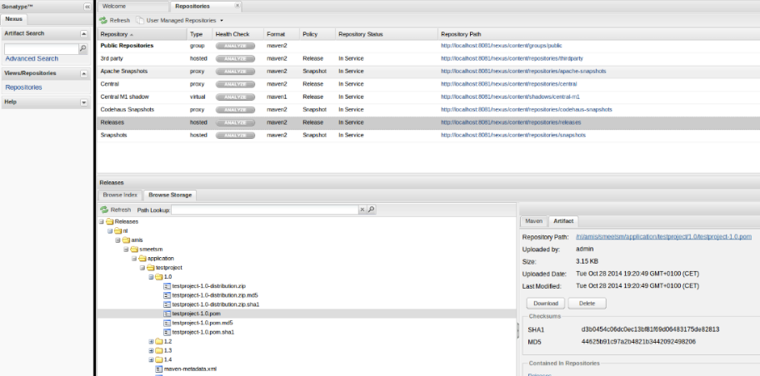
Using Nexus
Using Nexus
Nexus is used as the repository for build images.
Once a microService is built, it is stored in the Nexus repository in Docker format.
Nexus also stores the runtime systems to enable the transfer of microService build images.
Nexus has a GUI interface that is used to manage the build images for microServices.
For more information, refer to http://www.sonatype.org/nexus/.
Runtime
Notes:
For more information, refer to http://www.sonatype.org/nexus/.

Slide 55

Container
microServices are deployed into a container
Docker is used to run the microService, with it’s dependencies for portability, and ease of deployment.
The standard container used in CDP is Docker.
Docker is widely documented.
All of the features of Docker are available for use.
For more information, refer to https://www.docker.com/.
Runtime
Notes:
For more information, refer to https://www.docker.com/.

Slide 56
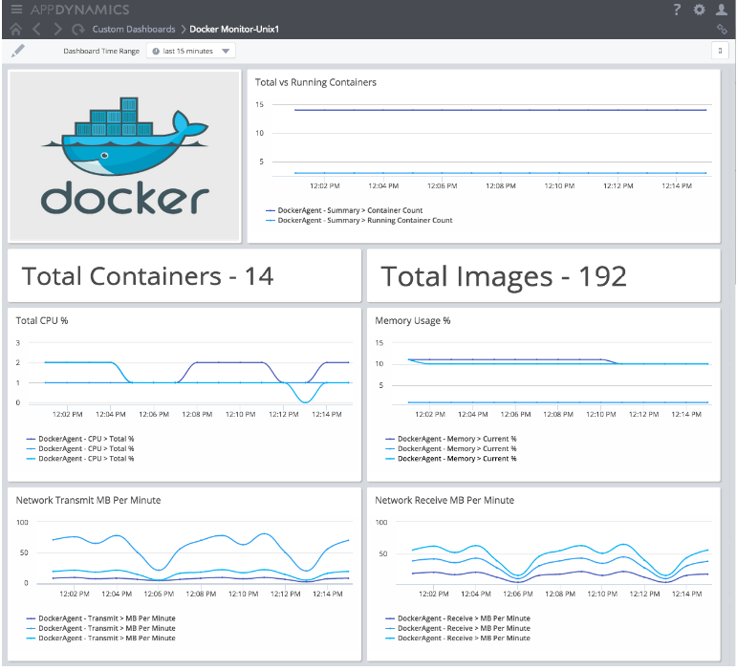
Using Docker
Docker
The Docker GUI is used to manage the container within the runtime environment.
It also helps to manage the build images from the Nexus repository.
Runtime

Slide 57
Container Management
Kubernetes is the container manager CDP uses
Kubernetes is used to automate the use of container-based applications.
Kubernetes deploys containers into pods.
Kubernetes manages the deployed containers, restarting or moving them as needed.
Containers can be scaled up or down as needed.
For more information, refer to https://kubernetes.io/.
Runtime
Notes:
For more information, refer to https://kubernetes.io/.

Slide 58
Registry
The GRM registry is used to track deployed services
When services are started, they are registered with GRM.
When a service needs to be located, the GRM registry is queried.
When services move, the registry is also updated.
When services are scaled up or down, the registry is updated.
Engineers can use GRM to locate services, if needed
This is NOT usually needed for diagnosis or monitoring (more on the next few slides).
Runtime

Slide 59

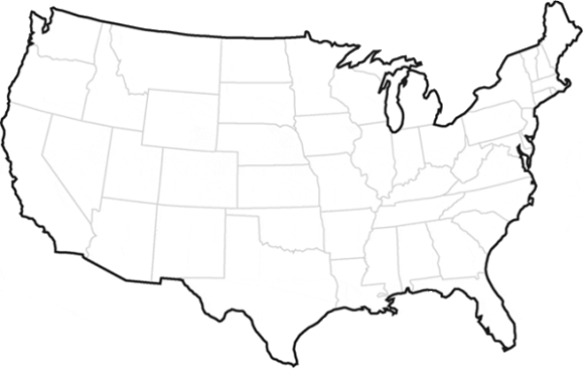
Registry
GRM Registry
An instance of a microService
Legend
mS
An application that wishes to use a microService
Each microService instance registers its existence with the GRM registry when it starts.
1
1
mS
1
mS
2
3
mS
The application (or other microService) accesses the registry to locate a desired microService to use.
2
mS
mS
The application (or other microService) can then access the microService and request operations of it.
mS
3
Runtime
Notes:
GRM is a globally available registry system that allows the registration of services and the identification of their location, as well as the lookup of those services by anyone that needs to access them.
The GRM registry is itself distributed and redundant across the entire country, but that is unimportant for this diagram.
When each microService is started, it will connect to and register itself with GRM.
This records the service name, and its location, in the global registry. This happens each time a service is started anywhere, no matter what the service is or where it is started, or how many copies of the service are started.
Whenever an application (or another service) needs to locate an instance of the service to request some operation, it contacts GRM and performs a lookup of the requested service.
GRM will use the location of the requestor to locate the service instance of the specified type that is geographically closest to the requestor. It will then return that service’ location and information needed to access the service.
The application, or other microService, uses the location and identify returned from GRM to access the requested microService.

Slide 60
Messaging and Discovery
DME2 is used as the discovery and messaging framework
DME2 services publish their existence in the GRM registry.
DME2 provides the ability to locate other DME2 services via the GRM registry.
Messages sent through DME2 can utilize dynamic discovery of the destination.
Runtime

Slide 61
Check Your Progress

Slide 62
Exercises
A+
Runtime
Nexus is used by CDP as the image repository. | True/False
CDP uses Docker to run the microServices. | True/False
Kubernetes is optional and is not required for CDP to run the Docker containers. | True/False
GRM is used to manage the registration of running microServices. | True/False
DME2 is used to perform distributed messaging. | True/False

Slide 63
Contents
Introduction
Workstation
CDP Infrastructure
Build System
Runtime
Monitoring
Monitoring
These are the tools used
to monitor the microService execution and are common for
all implementation technologies.
Notes:
To organize the information in this class, the standard tools are divided into five categories. These categories are:
Workstation – These are the tools that are standard and always installed and used by the engineer on their workstation environment.
CDP Infrastructure – These are the tools that are always used in all microService implementation technologies and form the basis for the CDP system itself
Build System – These are the tools used to perform the build, test, analysis, packaging, and repository management of the microService image. These tools will always be run within a Jenkin system, but the tools themselves will vary from one technology to another. This course describes the java-based microService tooling.
Runtime – These are the tools that are always used for every microService implementation to execute the microService.
Monitoring – These are the tools used to monitor the microService execution and are common for all implementation technologies.

Slide 64
Log Gathering
CDP uses Fluentd to gather logs and record them to a central point
Fluentd captures data from the Unified Logging Layer (ULL). ULL uses a logging method of automating log parsing by machine using data gathering and analytics.
Captures STDOUT and STDERR from the container.
Forwards the log records to an Elasticsearch cluster.
Fluentd is deployed with the container
It is always part of the runtime environment.
The microService does not need to define it.
It is always present and captures all log records, even if the container fails and is restarted, is moved, or is scaled up/down.
Montoring

Slide 65
Log Analysis
Log Analysis
CDP uses Elasticsearch to search and query log data
Elasticsearch receives all log records from Fluentd from all containers.
Elasticsearch stores the logs and provides query capabilities.
CDP uses Kibana to display log data
Kibana is the “front-end” to analyze and view the log data.
Kibana uses Elasticsearch.
Log analysis does not matter where the service is located, if it moves, or how many there are
Elasticsearch and Kibana are well-known locations that will not move.
Montoring

Slide 66
Metrics Gathering
CDP uses Prometheus to gather and analyze metrics data.
Prometheus captures and records the microService metrics on the Prometheus server.
microServices can move, fail and restart, or be scaled up/down and metrics are still captured and recorded.
Metrics include…
…node-level metrics.
CPU utilization
File system statistics
Memory utilization
System load
…cluster-level metrics.
Pod and Container CPU, memory, and network utilization
…microService metrics.
Request count
JMX (Java Management eXtensions) metrics, including heap and thread data
Application-specific metrics
Montoring

Slide 67
Alerting and Alarms
CDP does not prevent the use of standard alerting and monitoring tools
Nagios can be used to monitor the microService
Nagios alerts work as usual
Nagios can be integrated with Prometheus
Montoring

Slide 68
Check Your Progress

Slide 69
Exercises
A+
Monitoring
Fluentd must be included in the microService construction. | True/False
CDP provides Elasticsearch and Kibana systems for all microServices. | True/False
Alerting software cannot be used with microServices under CDP. | True/False

Slide 70
Answers to Exercises

Slide 71
Answers to Exercises - Introduction
A+
Introduction to Standard Tools and Framework
The workstation tools will likely be the same for all microService technologies. | True
The build system tools used to construct, package, and test the microService do not change for different implementation technologies. No, the build tools especially will change for different implementation technologies. Some languages may require SDK-like environments, and the tools used to compile (if applicable), perform source analysis, perform unit testing, and packaging are likely going to be different from technology to technology. | False
71

Slide 72
Answers to Exercises
A+
Workstation
Eclipse is a free, open-source, extensible integrated development environment (IDE). | True
Eclipse can be used only to develop java applications. No, Eclipse can be used to develop many different types of applications and has extensive support for many different languages. The IDE environment can be highly configured and customized with specialized tools and capabilities through the use of plugins and perspectives. | False
Eclipse packages cannot be extended or changed after download. No, Eclipse packages are conveniences only. They include the workbench and a set of plugins and features that are downloaded as a single set. Plugins and features may be added or removed at any time after the installation of the package. | False
Eclipse software releases are only available once each year as the simultaneous release. No, the annual simultaneous release is performed to synchronize the release of the workbench and the major projects that are being developed at the same time (such as web tools, c/c++ development tooling, java development tooling, etc.). The workbench and the plugins that comprise these projects are still developed and released independently throughout the year as corrections and new features are available. The simultaneous release is done primarily to ensure that the entire workbench and project distribution is tested and certified as a collection at the same time. | False
Eclipse plugins can only be downloaded from the Eclipse Software Foundation. Actually no, the Eclipse Software Foundation does maintain an extensive set of plugins that are available. However vendors and other open-source projects also publish and make available downloadable plugins. In many cases vendors provide plugins to support their products and provide the plugins for low cost or free. Open-source projects exist to develop and support plugins for special purposes, such as specialized file editors, specialized views, open-source code coverage tools, and many, many more. | False

Slide 73
Answers to Exercises
A+
CDP Infrastructure
Every microService deployed into production must be registered in the microService Catalog. | True
The microService catalog contains all of the technical information about the microService. No, the microService catalog contains only business-related information about the microService. It does provide a link to an external web or wiki site that should be used to supply this detailed design information. | False
ECO actually manages the pipeline used to build a microService. | True
ECO provides templates to assist in the generation of different types of microServices. | True
Changes to the Git repository cannot be detected by ECO. The Git hooks allow for automated processes to be configured and added to Git. There is a hook that allows Git to send an Http message or event to another application whenever the repository has been changed. Eco listens for this event and can automatically trigger the pipeline process whenever the Git repository is updated. | False
The Git commit command commits your changes to the remote repository. No, the commit operation commits the changes from your local workspace to your local repository only. It has no effect on the remote repository. | False
77

Slide 74
Answers to Exercises
A+
Build System
Jenkins is a highly configurable, extensible, and flexible automation system used for building software. | True
CDP uses Jenkins to perform the build processes. | True
An SDK of some sort, appropriate for the technology of the microService, may be needed to be able to build it. | True
Unit testing is not performed by CDP in the build environment. No, unit testing can be performed by CDP on the pipeline, depending on the technology of the microService and the pipeline definition. | False
Source code analysis verifies that source conforms to a set of norms. | True
Test coverage reports on the success or failures of individual tests. No, test coverage reports on the percentage of source code statements that are actually being executed by the test cases and gives you an indication of how thorough your testing is. | False
78

Slide 75
Answers to Exercises
A+
Runtime
Nexus is used by CDP as the image repository. | True
CDP uses Docker to run the microServices. | True
Kubernetes is optional and is not required for CDP to run the Docker containers. No, Kubernetes (or K8S) is required and is always used by CDP to run the Docker containers. | False
GRM is used to manage the registration of running microServices. | True
DME2 is used to perform distributed messaging. | True
79

Slide 76
Answers to Exercises
A+
Monitoring
Fluentd must be included in the microService construction. No, Fluentd is automatically installed in each Docker image for you by CDP. You do not need to include it in your microService. | False
CDP provides Elasticsearch and Kibana systems for all microServices. | True
Alerting software cannot be used with microServices under CDP. Actually no, alerting software such as Nagios can be installed and deployed with the microService without any conflicts. | False
80

